Slide 1
Illinois Valley Flood Resiliency Alliance
Senator Sue Rezin, 38th Senatorial District, Illinois

Slide 2
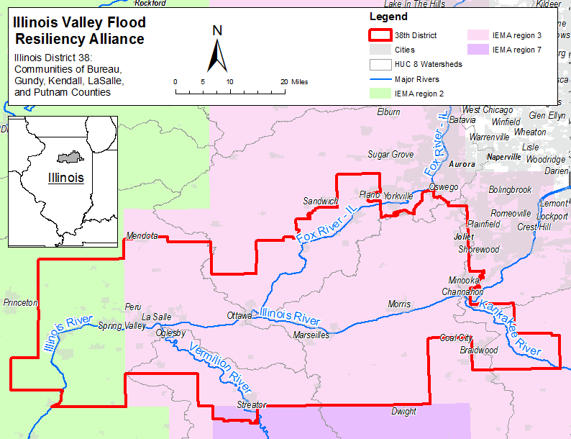

Slide 3
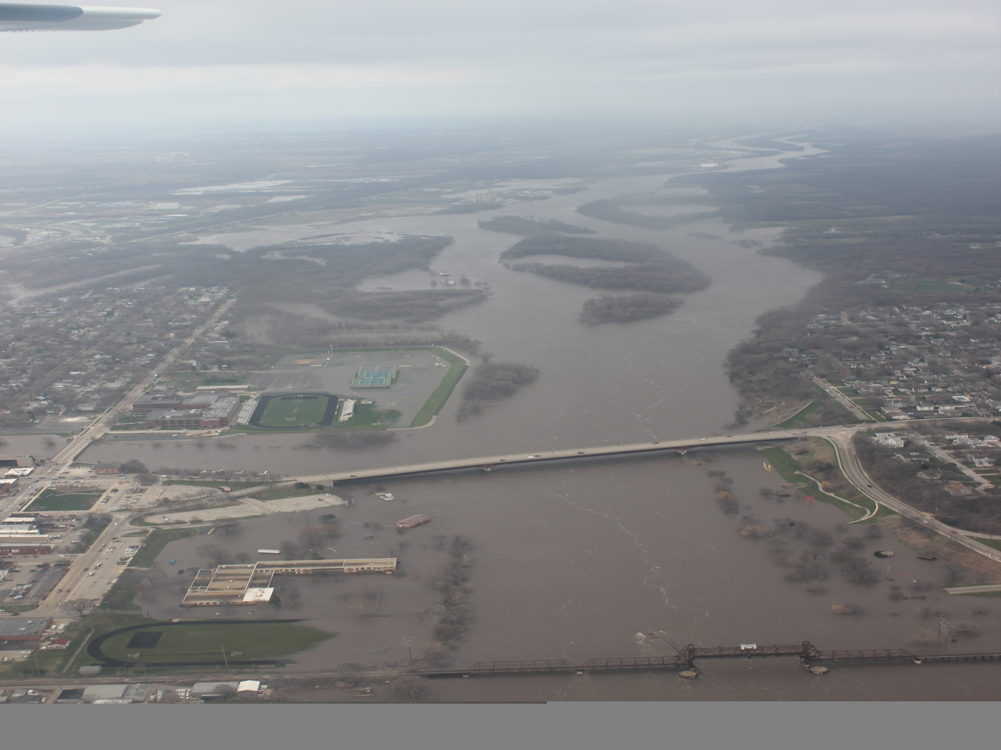

Slide 4
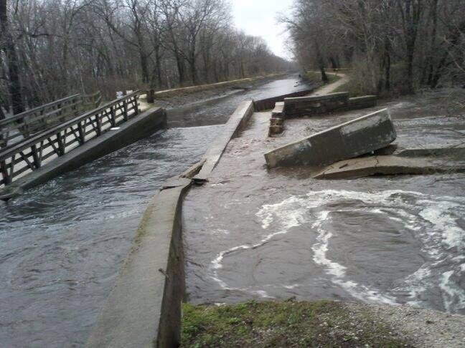
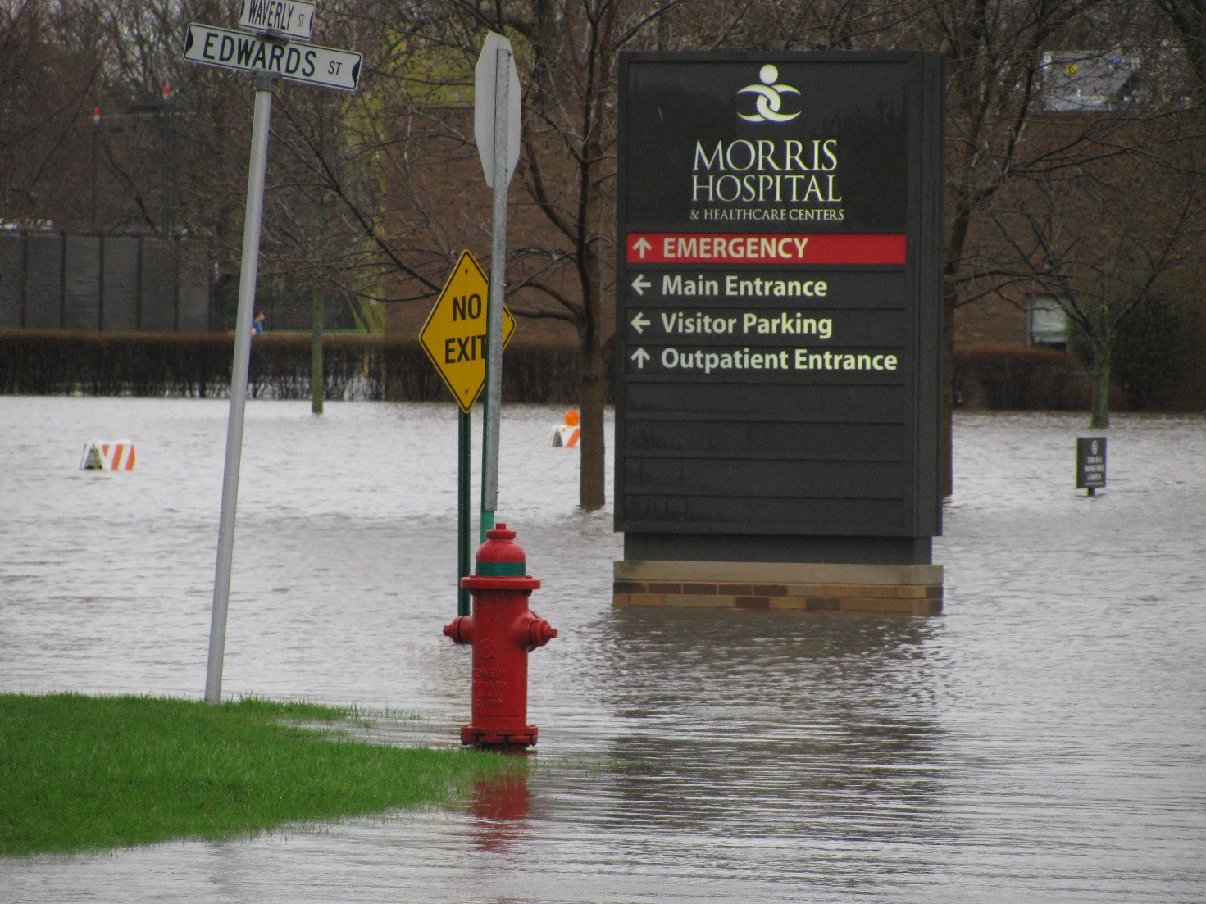
Morris Hospital
Forced Evacuation
2.5 Million in damage
AuxSable Aqueduct
Failure caused hospital to flood

Slide 5
Waste Water Treatment
School
Police Station/Village Hall
Hospital
Township High School
County Nursing Home

Slide 6
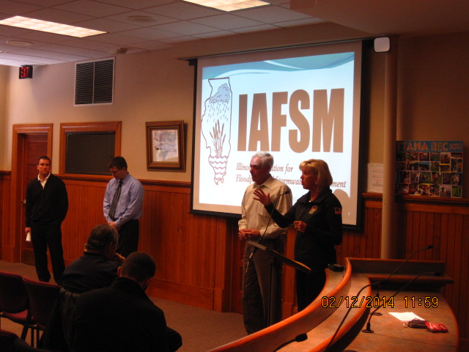
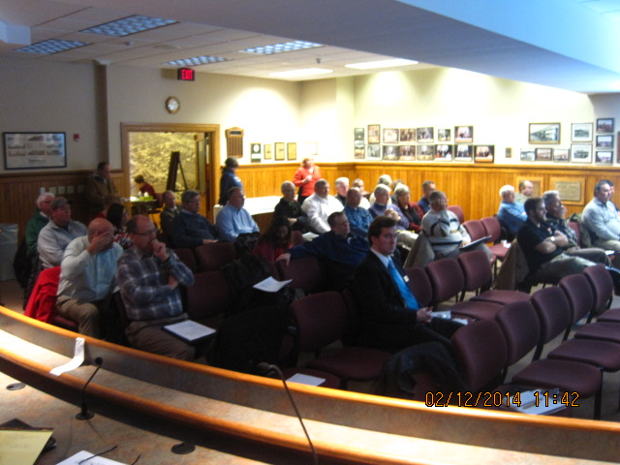
Dear Mayor:
As you well know, your community has recently been affected by flood related damages. The flooding this past spring was disastrous for many communities in the Illinois River watershed, including many in my District. Since that Federal Disaster of April 2013, I have worked with my constituents to identify the challenges that face our flood prone communities. While many of your flood community issues may be complex and seem difficult to resolve, there are technical resources and programs available to help successfully solve and mitigate flood related problems. I have found that the Federal Government, FEMA, Homeland Security, the Insurance Service Office, Illinois Emergency Management Agency and Illinois Department of Natural Resources each have resources to help us deal with the post flood challenges at hand, and to help us prevent flood damages in the future.
In an effort to share information, promote sound floodplain management practices, and save the taxpayer dollars I would like to form a coalition of Illinois River watershed communities. We can learn from one another. Joining together with other communities in similar situations has a synergistic benefit. Some communities in Illinois have had tremendous success in mitigating flood losses and we can collectively learn from their experiences. Ottawa, Illinois, in the late 1990’s was one of the worst repetitive loss communities in the State. Today that community has eliminated much of their flood risk and is ranked at the top of the Community Rating System which allows their citizens the benefit of a 25% discount on flood insurance premiums.
The Illinois Department of Natural Resources, Office of Water Resources, The U.S. Army Corps of Engineers, the Illinois Association of Floodplain and Stormwater Managers and the City of Ottawa have all agreed to assist my office in the formation of a coalition of flood prone communities in my district. To that end I am asking your participation in this endeavor. I am proposing that we have an initial formational meeting on February 12, 2014. The City of Ottawa has offered the use of their Council Chambers.

Slide 7
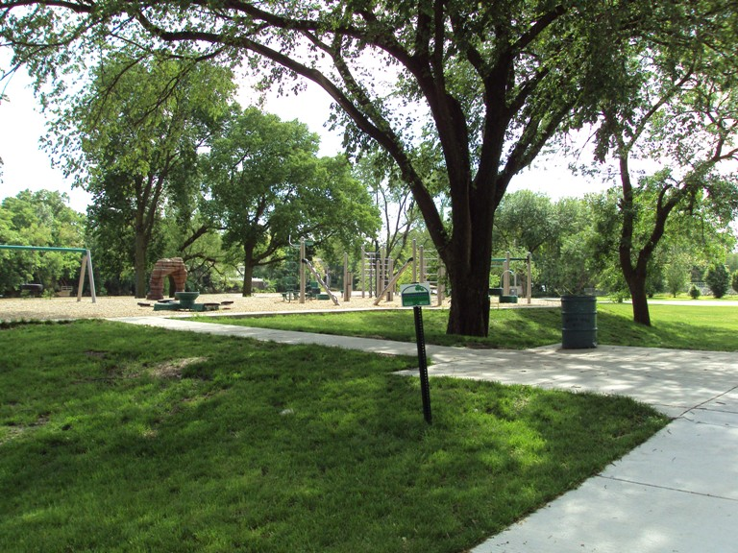
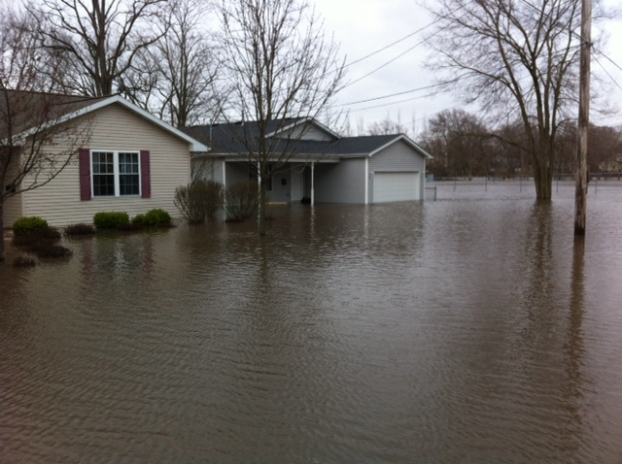
THIS
NOT THIS
County, State and Federal Regulations only work when enforced at the local level!
Local Office:
103 Fifth Street Peru, IL 61354 Phone: 815-220-8720 Fax: 815-220-8721

Slide 8
Creating an Action Plan for the Illinois Valley Flood Resiliency Alliance a Template for Forming Regional Flood Coalitions Interagency Flood Risk Management Project Illinois Silver Jackets Team Illinois Valley Flood Resiliency Coalition Illinois State Incident Response Center Ottawa, LaSalle County, Illinois
Slides adapted from:
Paul Osman and Mike Sutfin, Illinois Valley Flood Resiliency Alliance article
Molly O’Toole & Associates, LTD., Proposal for Consulting Services to Develop the Illinois Valley Flood Resiliency Alliance, Illinois, October 12, 2015.
Interagency Flood Risk Management Project FY17 Proposal: Flood Zone Alliance

Slide 9
Presentation Outline
Overview of Illinois Valley Flood Resiliency Alliance
Formation of the IVFRA: a template for forming new regional coalitions
Results of IVFRA: measurable benefits for member communities and the surrounding area

Slide 10
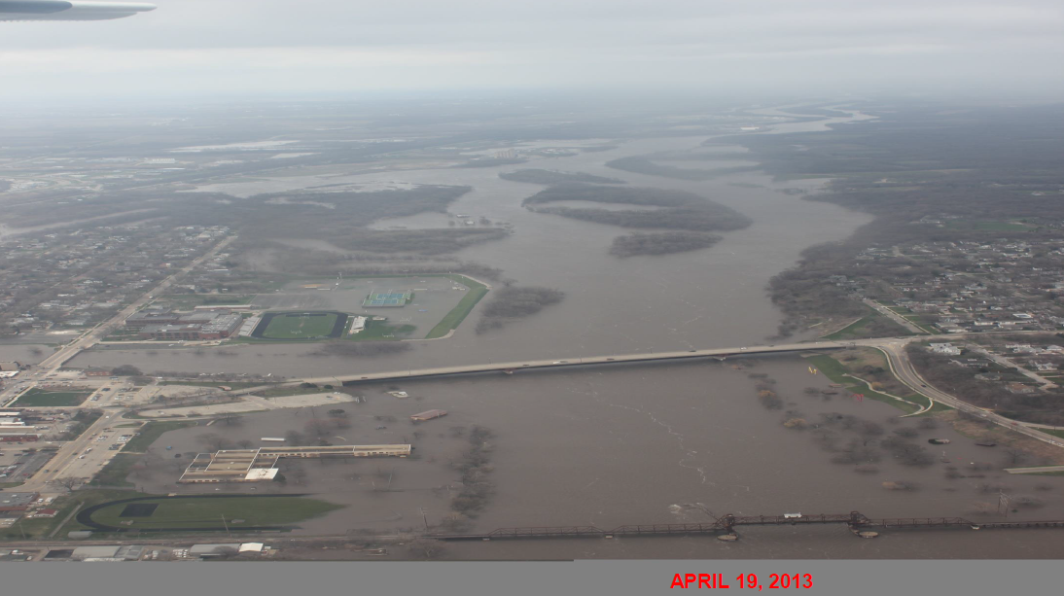
Overview
April 2013 flooding along the Illinois River.
Communities in Bureau, Grundy, Kendall, LaSalle, and Putnam Counties suffered major damage.
Senator Sue Rezin (Illinois District 38), organized these communities to work together to create a more flood resilient region.
The Illinois Valley Flood Resiliency Alliance (IVFRA) has identified needed steps for communities to be better prepared for future floods, and to implement measures to reduce flood damage
It is the intention of Senator Rezin that the regional alliance formed throughout her Senate district can be replicated in other districts to create a more flood resilient State of Illinois

Slide 12
Formation of the IVFRA: a template for forming new regional coalitions Step 1: Get Organized
1
9
Adopt the Plan
10
2
3
4
5
6
7
8
Organize
Involve the public
Coordinate w/ Agencies and Organizations
Assess the Hazard
Evaluate the Problem
Set Goals
Review Mitigation Strategies
Draft Action Plan
Implement, Evaluate, Revise
Get Organized
Set
Strategies
Implement
Plan
FEMA 10-step plan

Slide 13
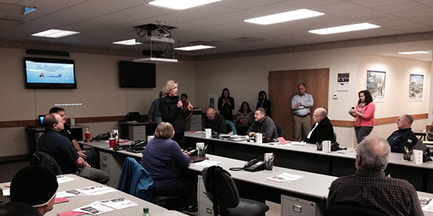
Get Organized
Initial Organization of Illinois Valley Flood Resiliency Alliance
Working with the City of Ottawa and the Illinois Office of Water Resources, Illinois State Senator Sue Rezin (38th district) formed a coalition of communities to work together and develop watershed-wide strategies to reduce future flood damages
Formed in 2013, the Illinois Valley Flood Resiliency Alliance now includes 5 counties and 18 communities

Slide 14
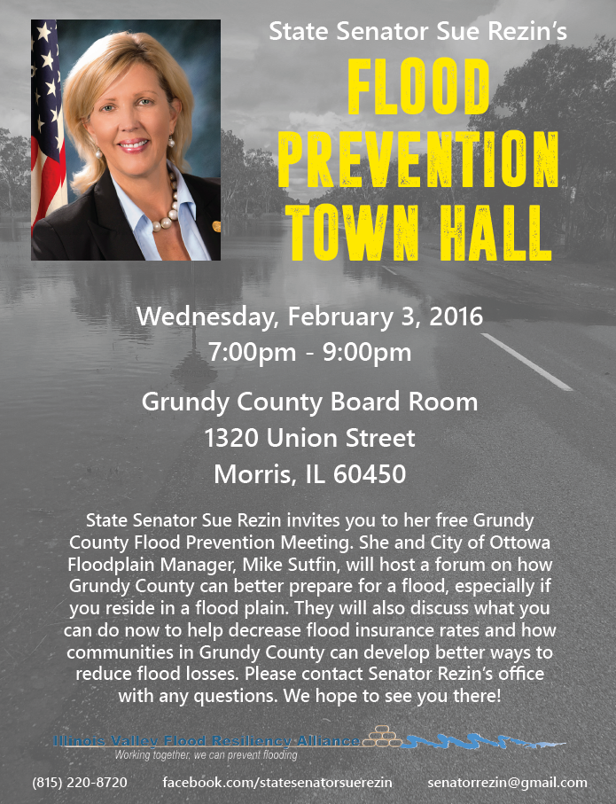
Get Organized
Public involvement
The Illinois Valley Flood Resiliency Alliance has encouraged communities to reach out to citizens and develop strategies to reduce flood risk exposure and increase flood insurance coverage.
Insurance agent workshops
Realtor workshops
Public meeting

Slide 15
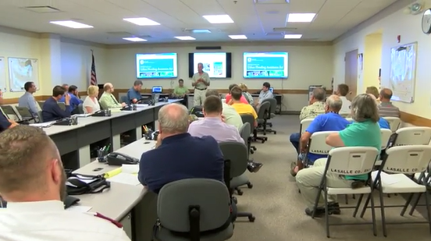
Get Organized
Other Agencies and Organizations
Illinois Office of Water Resources
Illinois Emergency Management Agency
Northcentral Illinois Council of Governments
University of Illinois
Illinois State Water Survey
U.S. Army Corps of Engineers
Natural Resources & Conservation Service

Slide 16
Formation of the IVFRA: a template for forming new regional coalitions Step 2: Set Strategies
1
9
Adopt the Plan
10
2
3
4
5
6
7
8
Organize
Involve the public
Coordinate w/ Agencies and Organizations
Assess the Hazard
Evaluate the Problem
Set Goals
Review Mitigation Strategies
Draft Action Plan
Implement, Evaluate, Revise
Get Organized
Set
Strategies
Implement
Plan
FEMA 10-step plan

Slide 17
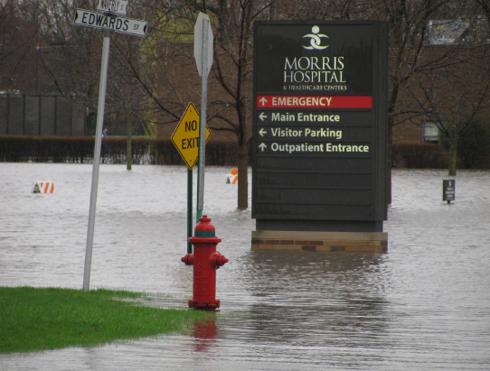
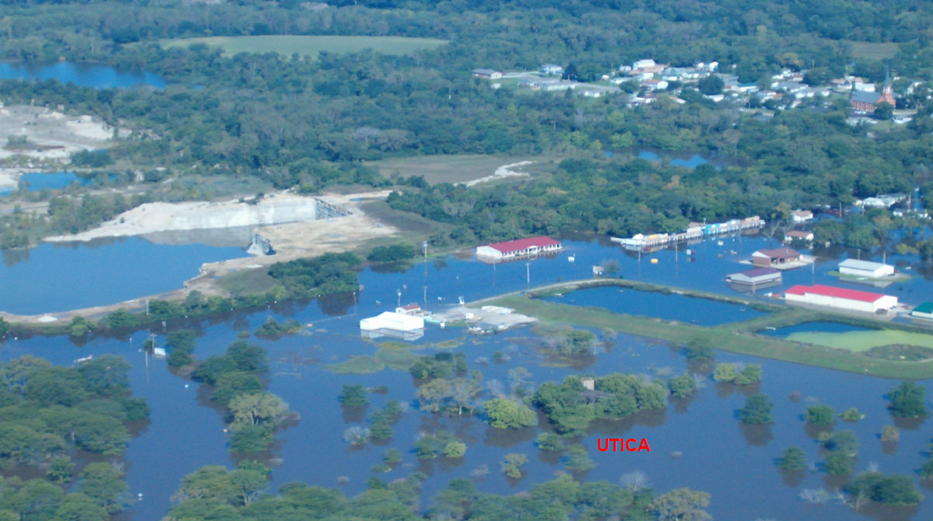
Set Strategies
Problem:
Every county in Illinois has had at least one declared flood disaster since 1993
Total flood damages in Illinois have been estimated to exceed $200 billion
Record flooding occurred along the Illinois River in the spring of 2013

Slide 18
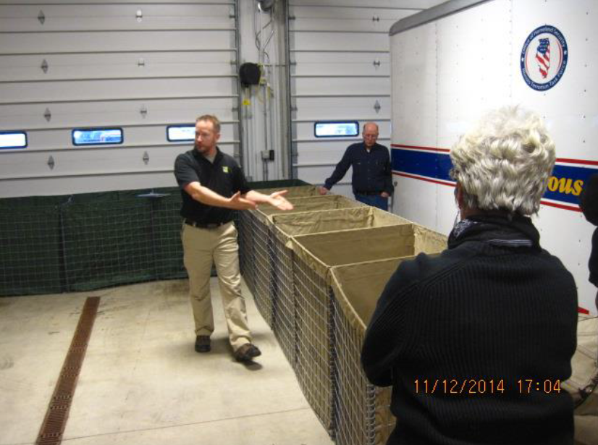
Set Strategies
The missions of the IVFRA are:
Have someone in each community become trained in floodplain management and become a Certified Floodplain Manager
Have each community join the National Flood Insurance Program’s Community Rating System and pursue flood insurance discounts
3. Have each community join the Illinois Association for
Floodplain and Storm water Management (IAFSM)
Encourage each community to adopt and enforce higher regulatory standards within their floodplains

Slide 19
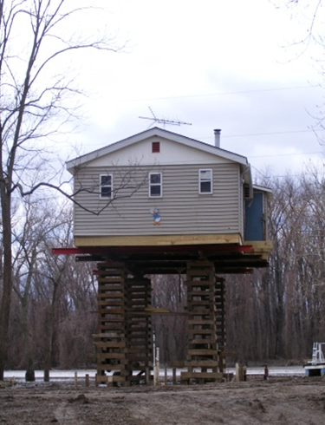
Set Strategies
The IVFRA continues to build on its mission points and review mitigation strategies to strengthen the coalition:
Preventative Measures
Consideration of codes, regulations, and higher standards
2. Property Protection
Review of elevation, acquisition, flood proof existing buildings
3. Structural Projects
Evaluation of flood control needs, protect infrastructure
4. Resource Protection
Attention to shorelines, wetlands protection, environmental concerns
5. Emergency Services
Assessment of flood warning, response needs for critical facilities and people
6. Public Information
Identification of regional outreach and public information needs

Slide 20
Formation of the IVFRA: a template for forming new regional coalitions Step 3: Implement plan
1
9
Adopt the Plan
10
2
3
4
5
6
7
8
Organize
Involve the public
Coordinate w/ Agencies and Organizations
Assess the Hazard
Evaluate the Problem
Set Goals
Review Mitigation Strategies
Draft Action Plan
Implement, Evaluate, Revise
Get Organized
Set
Strategies
Implement
Plan
FEMA 10-step plan

Slide 21
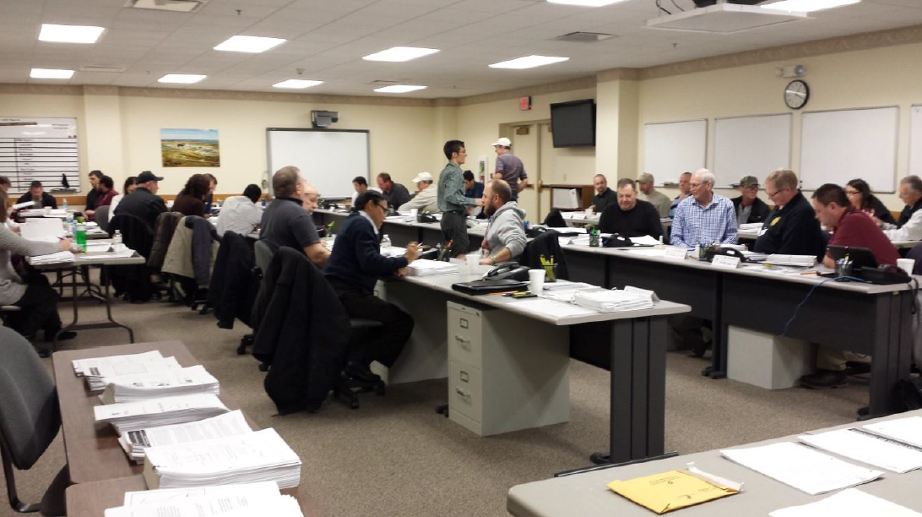
Implement Plan
Illinois Valley Flood Resiliency Alliance Accomplishments:
The Alliance of LaSalle, Grundy, Bureau, Kendall, and Putnam counties has developed an informal resiliency plan for the region
Alliance members meet quarterly to discuss best practices and strategies for flooding
Floodplain 101 and Elevation Certificate training conducted by the Illinois Office of Water Resources
Mitigation grant training conducted by the Illinois Emergency Management Agency and Northcentral Illinois Council of Governments
Floodplain mapping techniques by the University of Illinois / State Water Survey
Flood Fighting School by the U.S. Army Corps of Engineers
HAZUS tool and LiDAR acquisition by the University of Illinois

Slide 22
Implement Plan
Illinois Valley Flood Resiliency Alliance Accomplishments (continued):
Towns in the area are working on flood damage prevention ordinances that would fit their specific needs, restrictive zoning, and storm water regulations
24 new Certified Floodplain Managers in the 38th Senate district
Good relationships and friendships between IVFRA, Federal Government, and leaders in flood prevention
Mike Sutfin (City of Ottawa, IVFRA leader) on a federal Homeland Security task force interested in the outcome of this regional alliance and may potentially extend this model on a national level.
The U.S. Army Corps of Engineers secured Silver Jackets funding to assist the IVFRA in (a) documenting and building upon their action plan and (b) creating a template so that this concept can be replicated, scaled, and shared in other regions

Slide 23
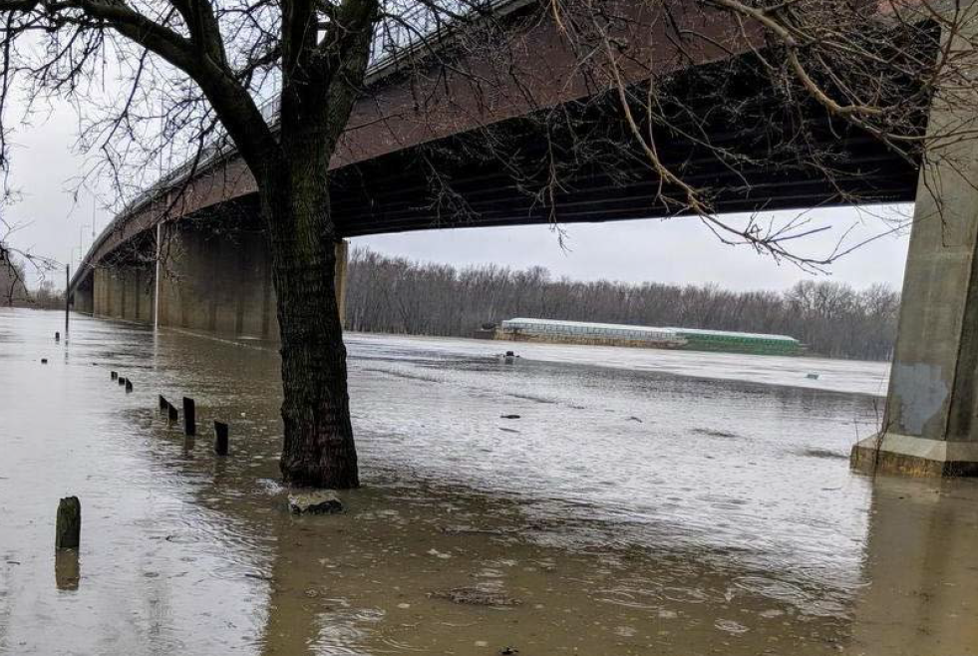
Results of IVFRA: The Illinois valley flood resiliency alliance has produced Measurable benefits for Member communities and the surrounding area
www.morrisherald-news.com

Slide 24
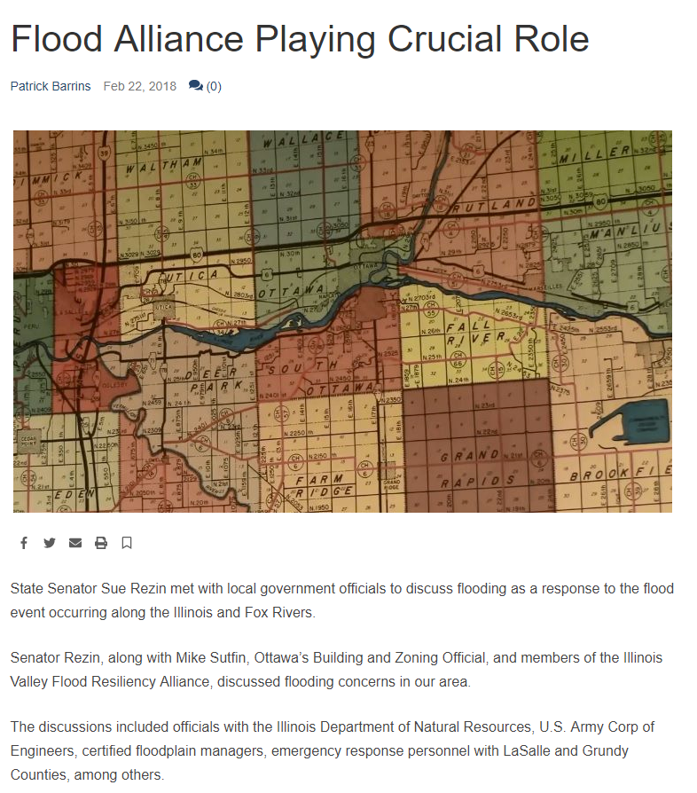
Results of IVFRA
Measurable benefit #1: Improved communication during February 2018 high water event response
“Senator Rezin, along with Mike Sutfin, Ottawa’s Building and Zoning Official, and members of the Illinois Valley Flood Resiliency Alliance, discussed flooding concerns in our area.”
“The discussions included officials with the Illinois Department of Natural Resources, U.S. Army Corp of Engineers, certified floodplain managers, emergency response personnel with LaSalle and Grundy Counties, among others.”
-wcsjnews.com

Slide 25
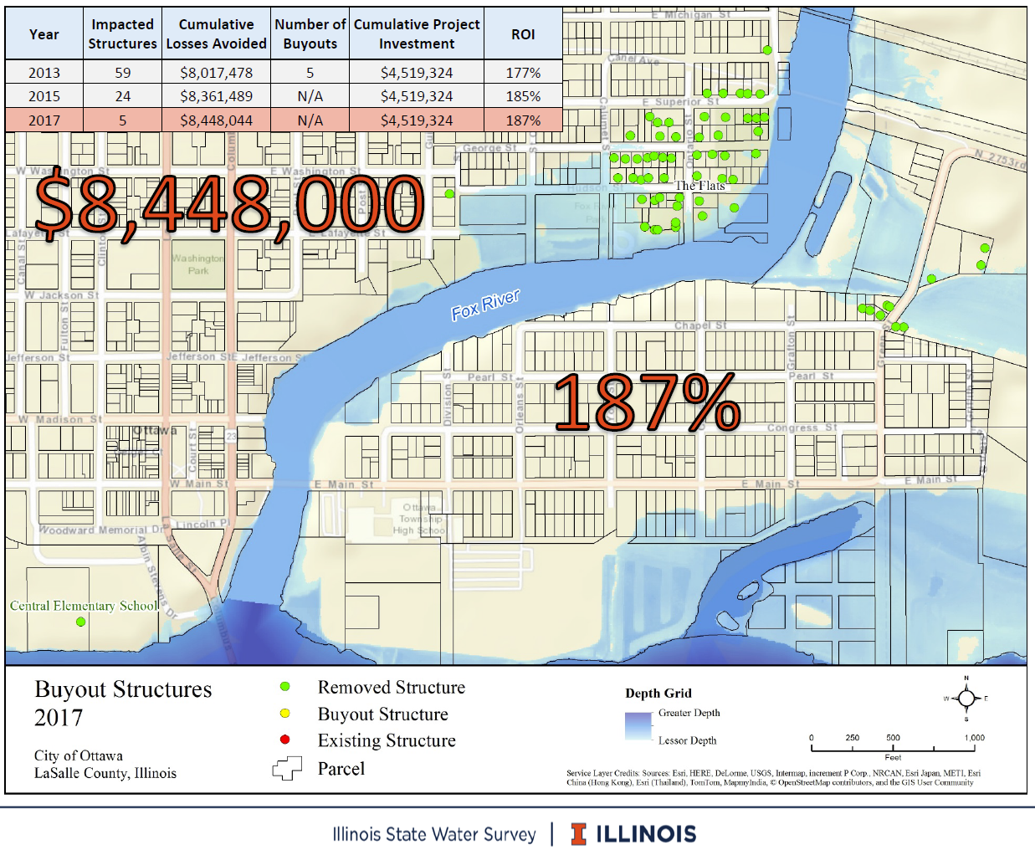
Results of IVFRA
Measurable benefit #2: University of Illinois HAZAS survey in City of Ottawa estimated return on investment and cumulative losses avoided from buyout structures since 1996.
ROI: 187%
Cumulative losses avoided: $8,448,000
McVay, B., Hanstad, C., and McConkey, S. “Estimating the Return on Investment of Buyouts: Loss Avoidance Study for the City of Ottawa, Illinois” PowerPoint presentation, Illinois State Water Survey, University of Illinois, 2018.

Slide 26
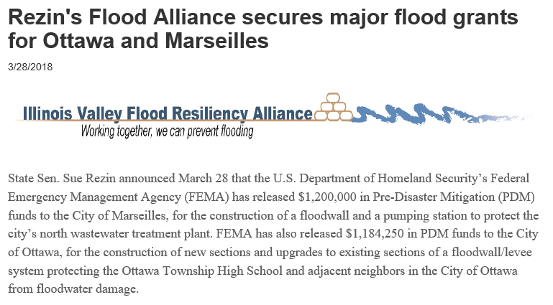
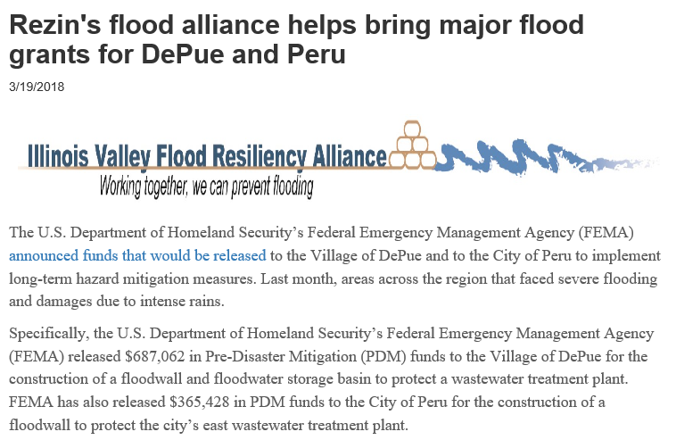
Results of IVFRA
Measurable benefit #3: Clear goals, collaboration, communication, and planning have brought federal grant money into local IVFRA communities.
“‘Out of 12 communities that received federal dollars, four of them are members of our Illinois Valley Flood Resiliency Alliance,’ State Sen. Sue Rezin said. ‘That speaks volumes to the values of our Flood Alliance. These are the positive things that can happen when we work together as one group.’”
-www.senatorrezin.com/News

Slide 27
Results of IVFRA
Measurable benefit #4: Nearby communities are interested in forming their own flood coalitions
State Senate district 37
State Senate district 53
Quad Cities River Action

Slide 28
Conclusions
The Illinois Valley Flood Resiliency Alliance is a cohesive, ‘disaster ready’ alliance with enhanced collaboration, communication, training, education, and mitigation.
With measurable benefits, the IVFRA directly protects citizens from flood hazards and save lives, property, and resources of local governments, municipalities, and residents.

Slide 29
Points of contact
Mike Sutfin
Building & Zoning Official, City of Ottawa
815-433-0161 ext. 219
msutfin@cityofottawa.org
Paul Osman
OWR Regulatory Programs NFIP and Floodplain Manager, IDNR
217-782-4428
paul.osman@illinois.gov
Anthony Heddlesten
U.S. Army Corps of Engineers, Peoria Flood Area Engineer
309-794-5886
Anthony.D.Heddlesten@usace.army.mil

Slide 30
IWA

Slide 31
Community Rating System

Slide 32
What Is The CRS?
FEMA program administered by ISO
Recognition for going above and beyond minimum NFIP standards
VOLUNTARY Incentive Program
19 creditable Activities
10 Class system. 500 pts. per Class
5% insurance premium discount per Class

Slide 33
Premium Discounts
Class Points SFHA Non‑SFHA
1 4,500 45% 10%
2 4,000 40% 10%
3 3,500 35% 10%
4 3,000 30% 10%
5 2,500 25% 10%
6 2,000 20% 10%
7 1,500 15% 5%
8 1,000 10% 5%
9 500 5% 5%
10 0 0

Slide 34
Benefits to Community
Better organized programs
Money stays in your community
Free technical assistance
Evaluation vs. State and National benchmarks
Public Information builds constituency
Improved flood protection
Incentive to keep implementing

Slide 35
CRS Activities
300 Public Information Activities
310 Elevation Certificates
320 Map Information
330 Outreach Projects
340 Hazard Disclosure
350 Flood Protection Information
360 Flood Protection Assistance

Slide 36
CRS Activities
400 Mapping & Regulatory Activities
410 Additional Flood Data
420 Open Space Preservation
430 Higher Regulatory Standards
440 Flood Data Maintenance
450 Stormwater Management

Slide 37
CRS Activities
500 Flood Damage Reduction Activities
510 Floodplain Management Planning
520 Acquisition & Relocation
530 Flood Protection
540 Drainage System Maintenance

Slide 38
CRS Activities
600 Flood Preparedness Activities
610 Flood Warning Program
620 Levee Safety
630 Dam Safety
www.crsresources.org

Slide 39
Premium Discounts
Class Points SFHA Non‑SFHA
1 4,500 45% 10%
2 4,000 40% 10%
3 3,500 35% 10%
4 3,000 30% 10%
5 2,500 25% 10%
6 2,000 20% 10%
7 1,500 15% 5%
8 1,000 10% 5%
9 500 5% 5%
10 0 0

Slide 40
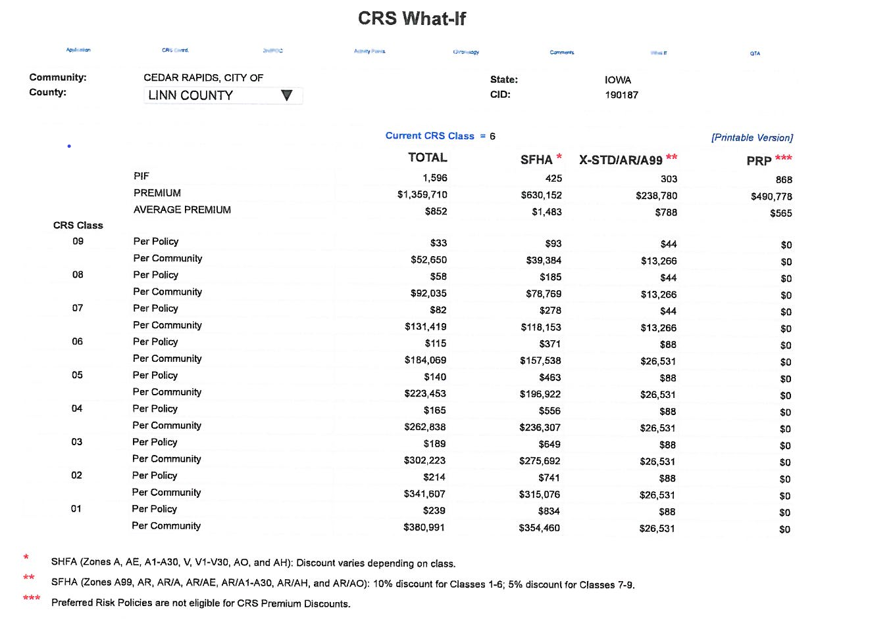

Slide 41
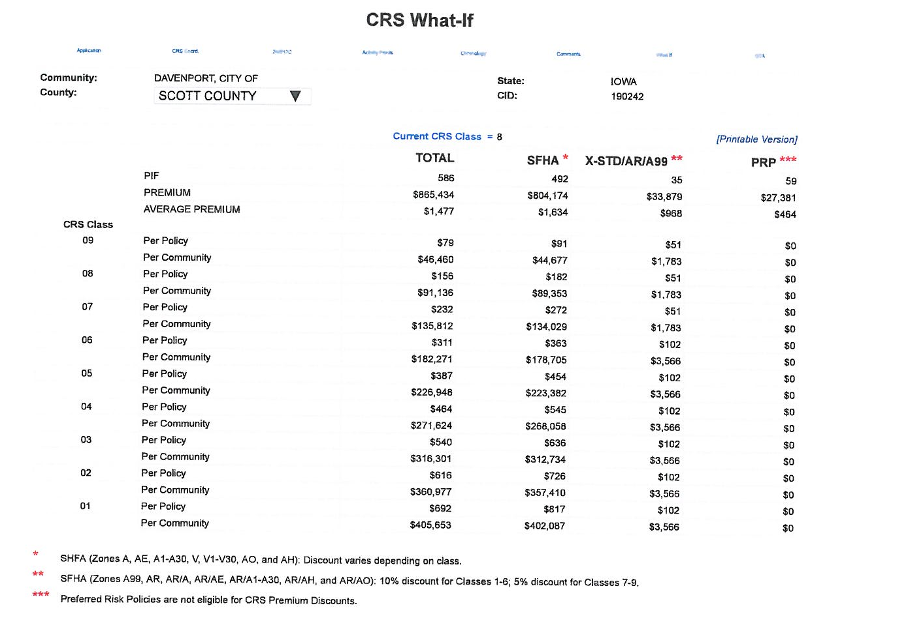

Slide 42
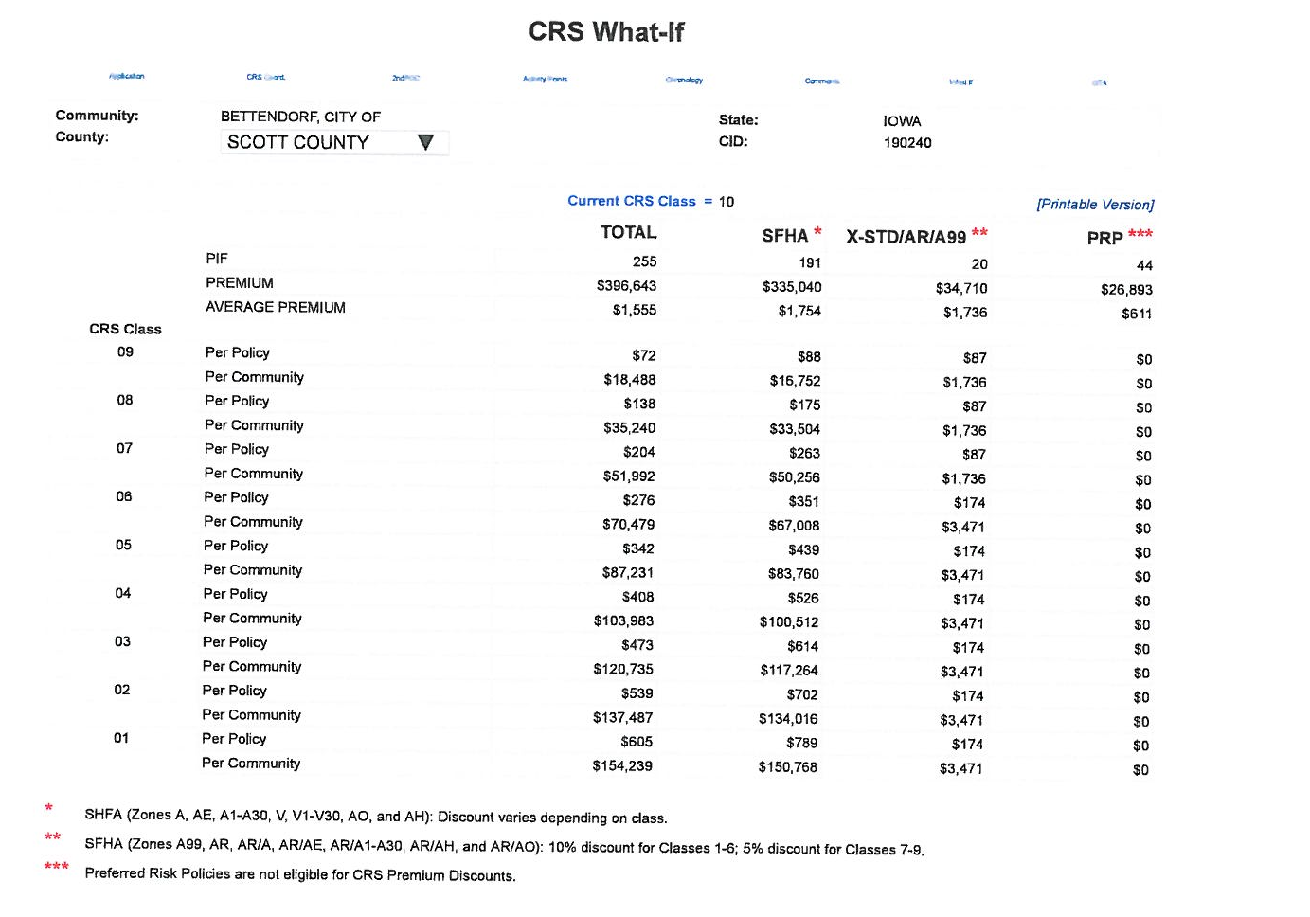

Slide 43
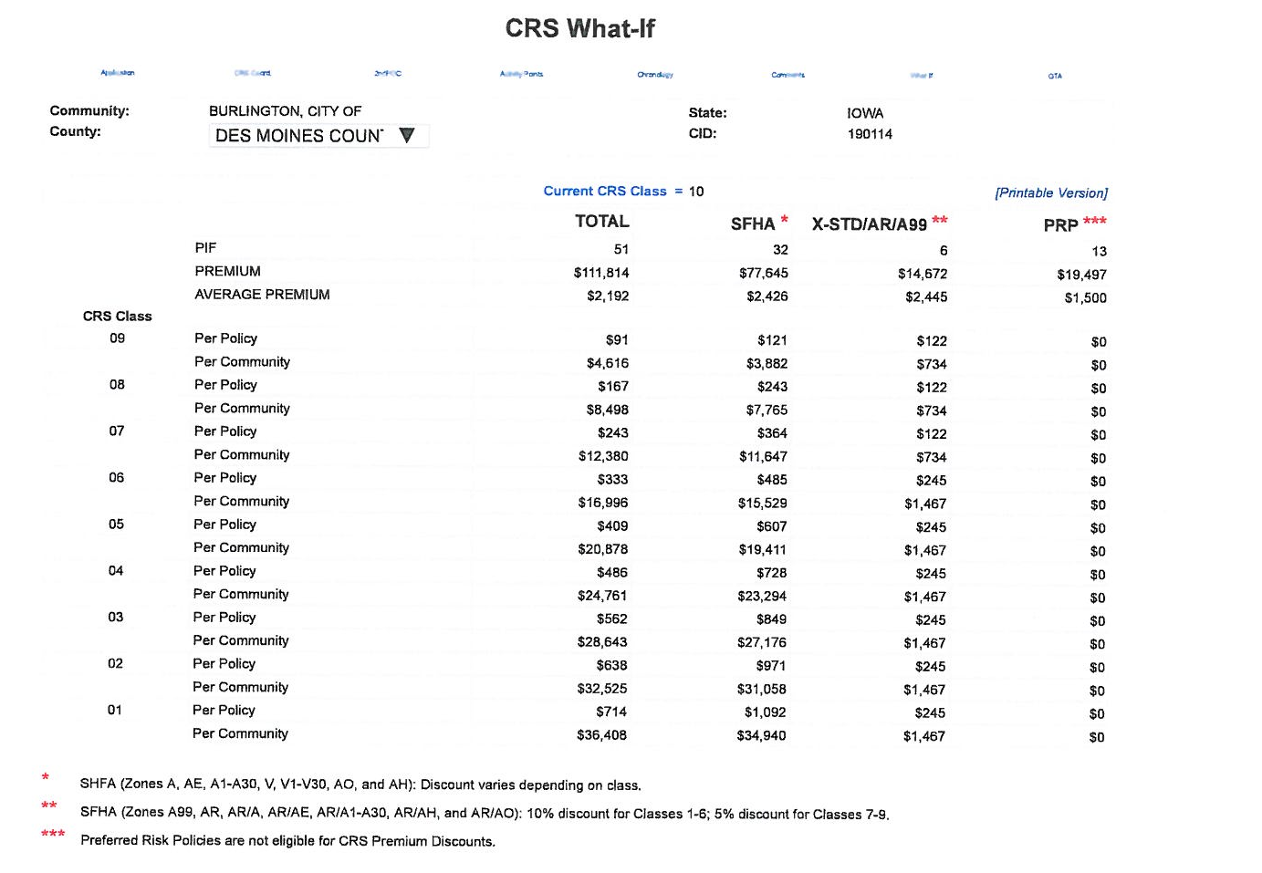

Slide 44
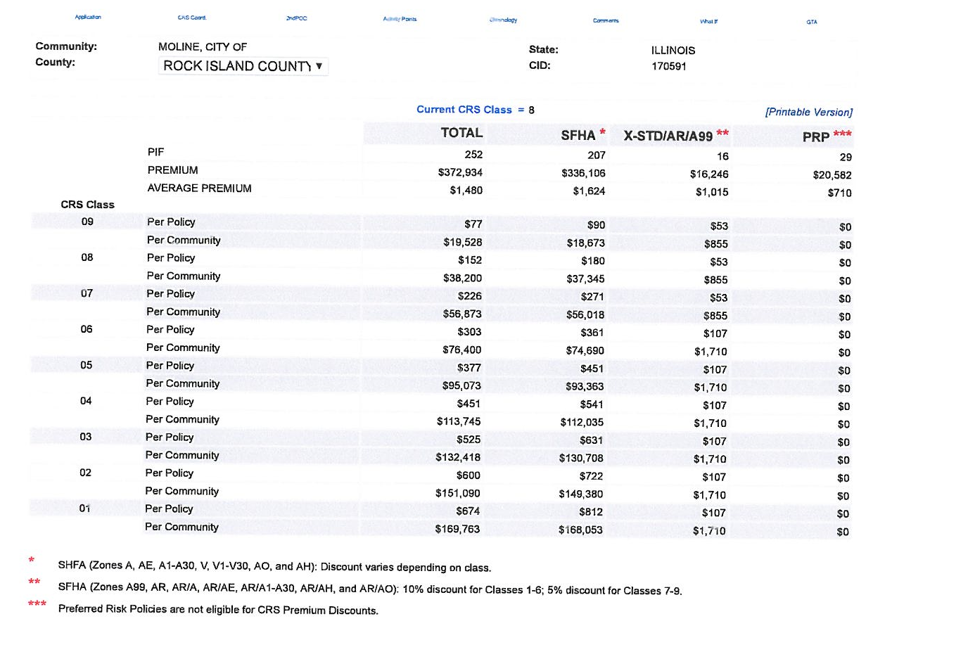

Slide 45
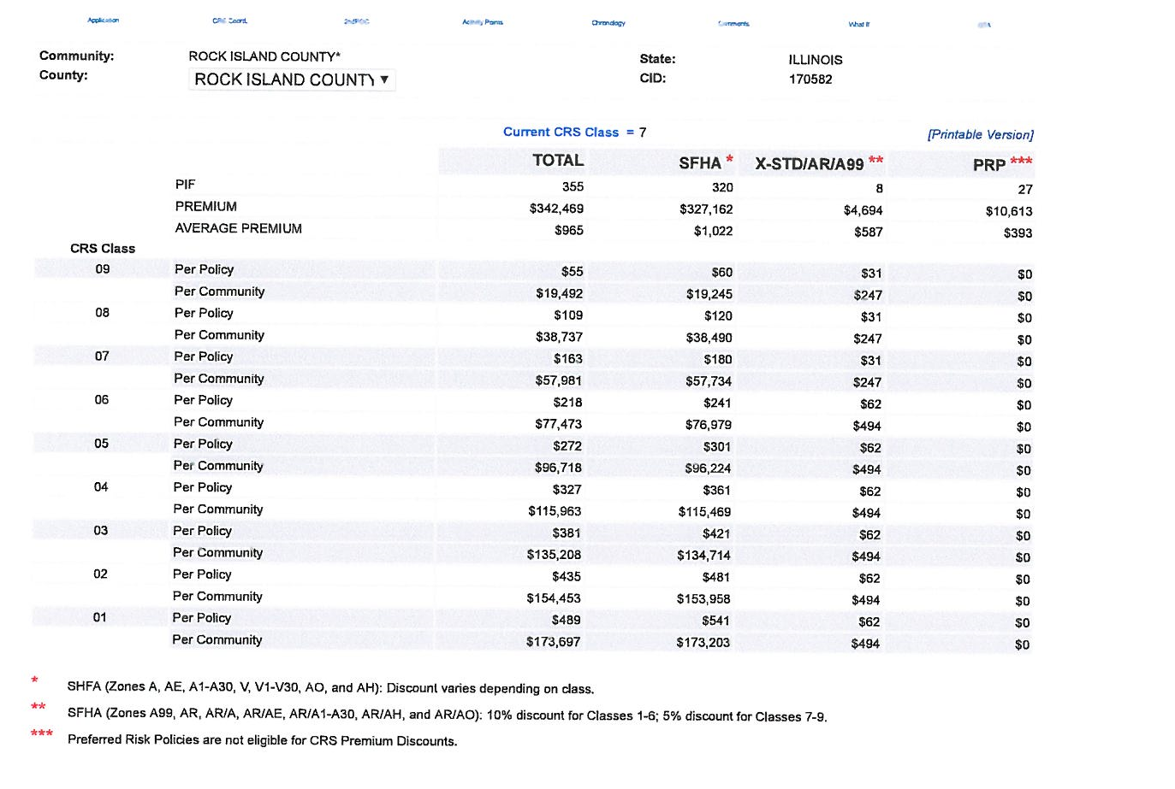

Slide 46
